Slide 1
Welcome to the
Hotel Logo Quiz Game!
Correctly guess as many hotel logos as possible—there are 20 in all!
When finished playing the game, please click “Return to Start” so the game will be ready for the next person.
Thanks, and good luck!
Start Game →

Slide 2
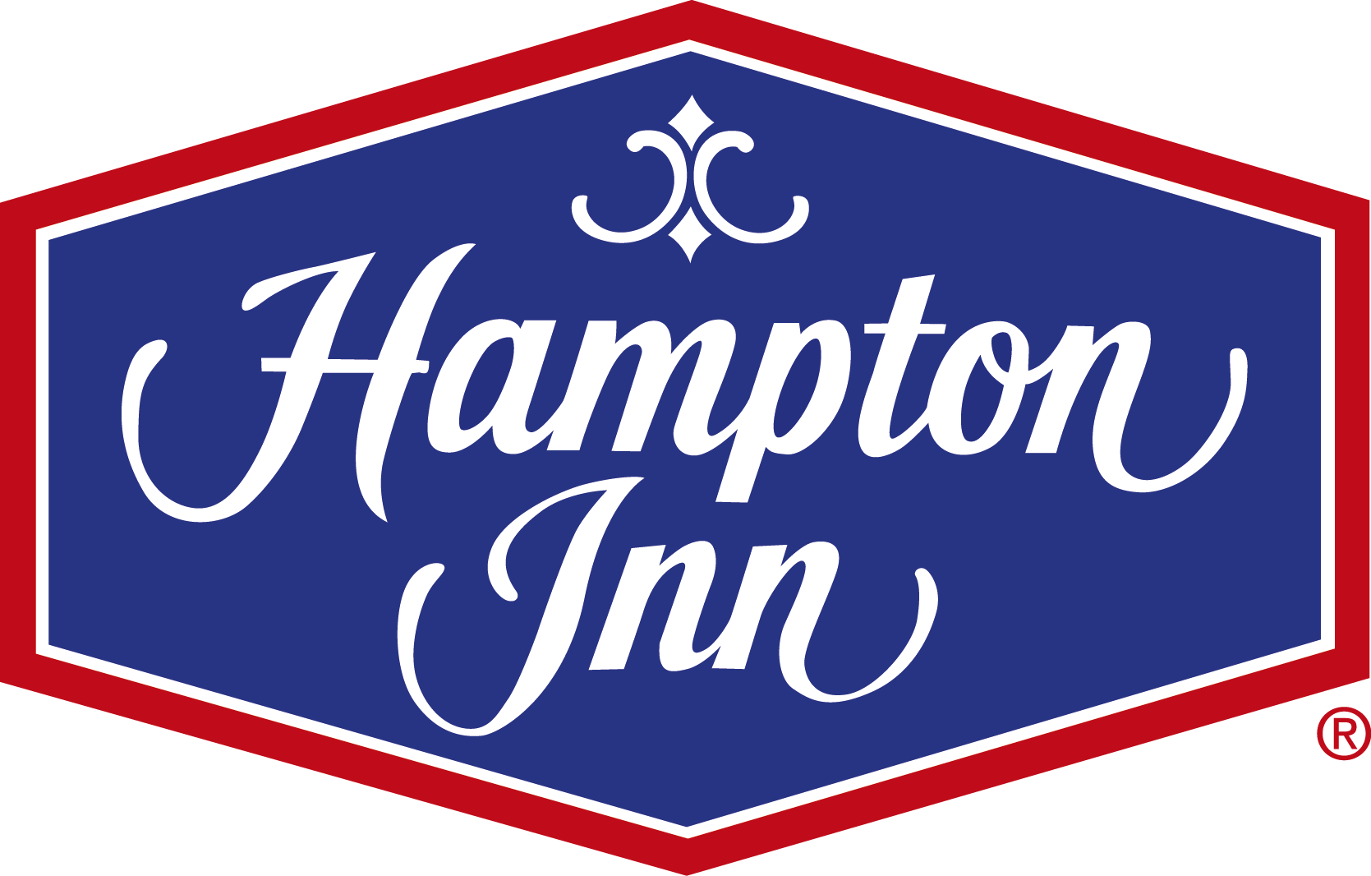
Guess the Hotel Logo
#1
Click for Answer
Home

Slide 3
Guess the Hotel Logo
#1
Hampton Inn
Next Logo →
Home

Slide 4
Guess the Hotel Logo
#2
Click for Answer
Home

Slide 5
Guess the Hotel Logo
#2
Days Inn
Next Logo →
Home

Slide 6
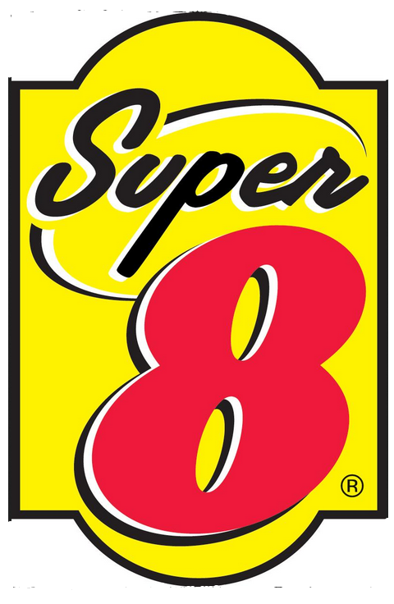
Guess the Hotel Logo
#3
Click for Answer
Home

Slide 7
Guess the Hotel Logo
#3
Super 8
Next Logo →
Home

Slide 8
Guess the Hotel Logo
#4
Click for Answer
Home

Slide 9
Guess the Hotel Logo
#4
Holiday Inn
Next Logo →
Home

Slide 10
Guess the Hotel Logo
#5
Click for Answer
Home

Slide 11
Guess the Hotel Logo
#5
Crowne Plaza
Next Logo →
Home

Slide 12
Guess the Hotel Logo
#6
Click for Answer
Home

Slide 13
Guess the Hotel Logo
#6
Courtyard by Marriott
Next Logo →
Home

Slide 14
Guess the Hotel Logo
#7
Click for Answer
Home

Slide 15
Guess the Hotel Logo
#7
La Quinta Inn
Next Logo →
Home

Slide 16
Guess the Hotel Logo
#8
Click for Answer
Home

Slide 17
Guess the Hotel Logo
#8
Four Seasons Hotel
Next Logo →
Home

Slide 18
Guess the Hotel Logo
#9
Click for Answer
Home

Slide 19
Guess the Hotel Logo
#9
Marriott
Next Logo →
Home

Slide 20
Guess the Hotel Logo
#10
Click for Answer
Home

Slide 21
Guess the Hotel Logo
#10
Westin Hotels and Resorts
Next Logo →
Home

Slide 22
Guess the Hotel Logo
#11
Click for Answer
Home

Slide 23
Guess the Hotel Logo
#11
Comfort Inn
Next Logo →
Home

Slide 24
Guess the Hotel Logo
#12
Click for Answer
Home

Slide 25
Guess the Hotel Logo
#12
Sheraton
Next Logo →
Home

Slide 26
Guess the Hotel Logo
#13
Click for Answer
Home

Slide 27
Guess the Hotel Logo
#13
Hilton Hotels and Resorts
Next Logo →
Home

Slide 28
Guess the Hotel Logo
#14
Click for Answer
Home

Slide 29
Guess the Hotel Logo
#14
Best Western Hotel
Next Logo →
Home

Slide 30
Guess the Hotel Logo
#15
Click for Answer
Home

Slide 31
Guess the Hotel Logo
#15
Hilton Garden Inn
Next Logo →
Home

Slide 32
Guess the Hotel Logo
#16
Click for Answer
Home

Slide 33
Guess the Hotel Logo
#16
Loews Hotels
Next Logo →
Home

Slide 34
Guess the Hotel Logo
#17
Click for Answer
Home

Slide 35
Guess the Hotel Logo
#17
Econo Lodge
Next Logo →
Home

Slide 36
Guess the Hotel Logo
#18
Click for Answer
Home

Slide 37
Guess the Hotel Logo
#18
Quality Inn
Next Logo →
Home

Slide 38
Guess the Hotel Logo
#19
Click for Answer
Home

Slide 39
Guess the Hotel Logo
#19
Waldorf Astoria
Next Logo →
Home

Slide 40
Guess the Hotel Logo
#20
Click for Answer
Home

Slide 41
Guess the Hotel Logo
#20
Ritz Carlton
Finish →
Home

Slide 42
Congratulations! You did it!
Thanks for playing the Hotel Logo Quiz Game!
Please click “Home” so other guests can enjoy playing this game. Thanks!
Home
We hope you had fun playing the game, and we invite you to check out our other interactive exhibits. Did you know you can taste “astronaut” ice cream at the Space: 66 Years and Counting exhibit, control a bus at the Bus Driver Training Zone exhibit, and design your own boat at the Float Your Boat exhibit?

